Slide 1

2020 Trip
to
SPAIN
BOOK YOUR SPACE TODAY!!!
ONLY 30 SPACES AVAILABLE!

Slide 2
Behaviour!!
If your child wishes to be a part of this experience, their behaviour has to ALWAYS be good inside and outside of school.

Slide 3
RESIDENTIAL TRIP TO SPAIN BEHAVIOUR RULES
Curwen behaviour rules apply on the trip
Is punctual to school and attends school (95% at least)
Homework, times-table practise
Listen and follow all adult’s instructions appropriately
While on the coach you must follow driver’s instructions
Look after our own and others properties (coach, accommodation, school in Spain, etc)
Keep accommodation clean and tidy
Take responsibility of your own actions
REMEMBER THAT WE ARE REPRESENTING CURWEN PRIMARY SCHOOL
Child & Parents to sign

Slide 4

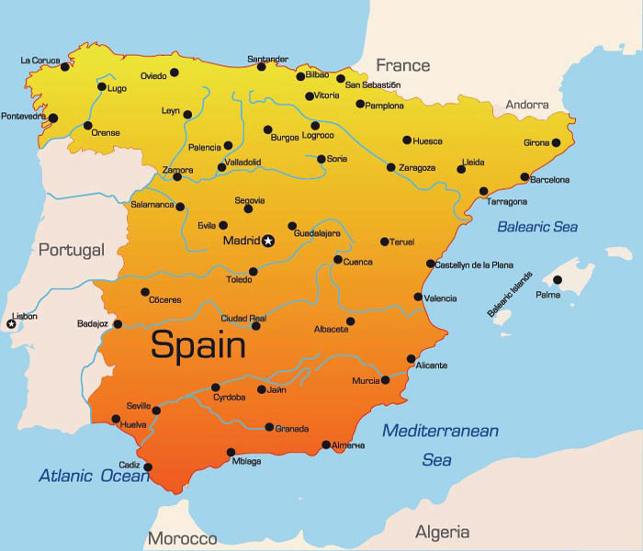
Where are we going?
When are we going?
Tuesday 2nd June 2019- Friday 5th June 2020

Slide 5
Why?
Drive students towards acceptance and understanding of different cultural communities
Enhanced interest in global issues as well as a broader understanding of the wider world
Encourage small-scale lifestyle changes
Enhance pupils’ awareness and interactions with diversity to support mutual respect
Support specific areas of the curriculum and build on classroom experience
Increase the profile of MFL in Curwen
Develop the use of Spanish into a daily school practice
Achieve language acquisition through practical immersion
Incorporate the use of Spanish in Cross-curricular activities
Develop a sense of achievement through their interaction with Spanish children
Set up the foundation to embark Curwen on an international adventure

Slide 6
The Impact:
Children at Curwen deserve every opportunity to expand their horizons and outlook in order to gain the best possible start in life. Many of our children have not left Plaistow/London let alone the country. This trip will enable our children, in a safe and educational manner, to gain a greater understanding of different cultures and traditions of another country. Not only will it feed their curious minds but enhance their appreciation of travel, demonstrating to them that there are opportunities and prospects outside of Plaistow/London/UK. Not only will it build their independence and resilience but as residential trips to places such as Fair Play House have shown, it will build their self-confidence and will also inspire children in future year groups to share similar experiences. Studies show that one of the best ways to improve one’s language acquisition (NC requirement - MFL) is to immerse oneself in that environment and culture. What better place to improve their Spanish than in Spain itself? We hope that a trip like this will improve the speaking and listening skills of those involved whilst giving each individual an experience of a lifetime.

Slide 7
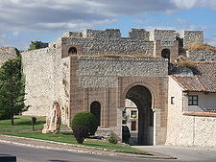
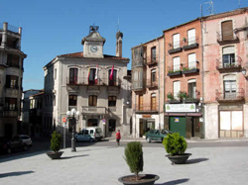
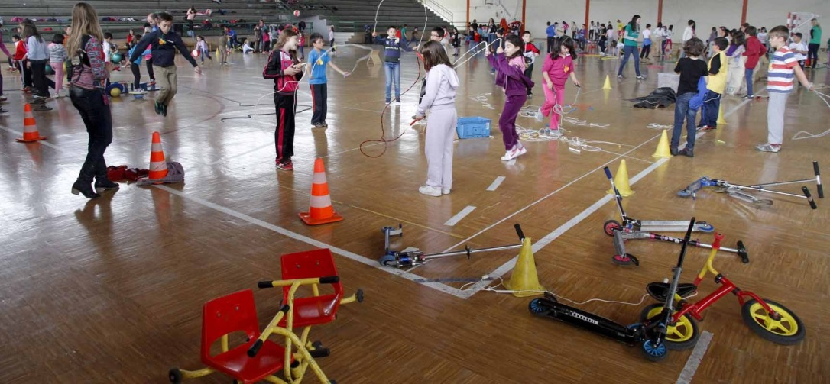
About Cuellar
A small rural village
It is 165 km from Madrid airport
Only 3 primary schools
Lots of historical architecture
Strong Spain heritage
Villager live by an authentic Spanish culture

Slide 8
Why Cuellar
Curwen and Santa Clara have built strong links over the past 5 years
Have visited Curwen three times
Pupils are familiar with both the teachers and the pupils
Summer holiday club activities

Slide 9
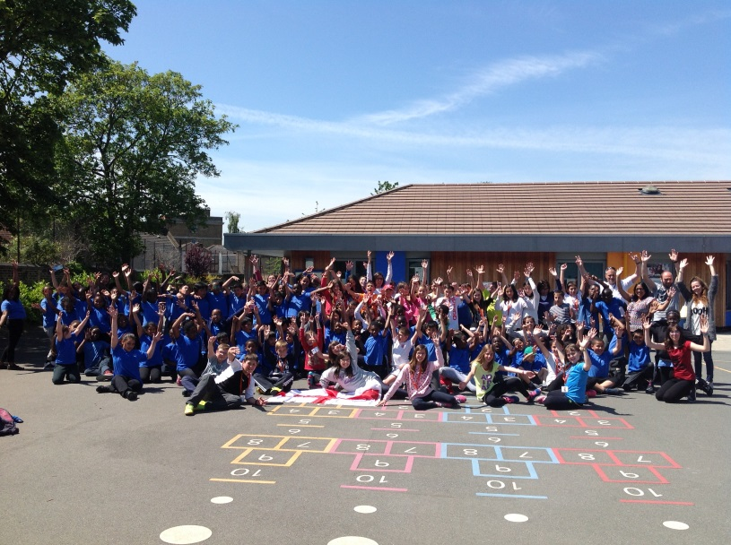
Santa Clara Primary School
It is a community school like Curwen
350 pupils
It is a British council school
They have visited Curwen for the past 3 years
Their next visit is 8th to 11th June 2020
Activities & trips with pupils from both schools
http://www.kizoa.es/slideshow/d26919659k5258334o2
http://ceipsantaclara.centros.educa.jcyl.es

Slide 10
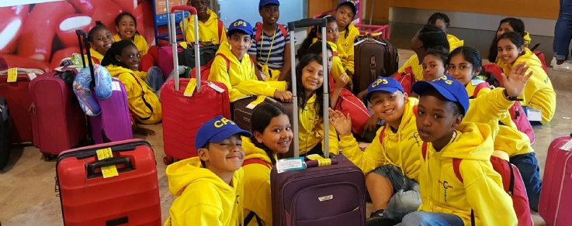
Last Year’s Trip
Now 25% of Year 5 pupils from Curwen have visited Spain.
Pupils were able to make links between the history taught through the Curwen curriculum and the architecture and history in the various locations visited in Spain.
The authentic Spanish nature of Segovia inspired rich conversation and both children and staff were in awe.

Slide 11
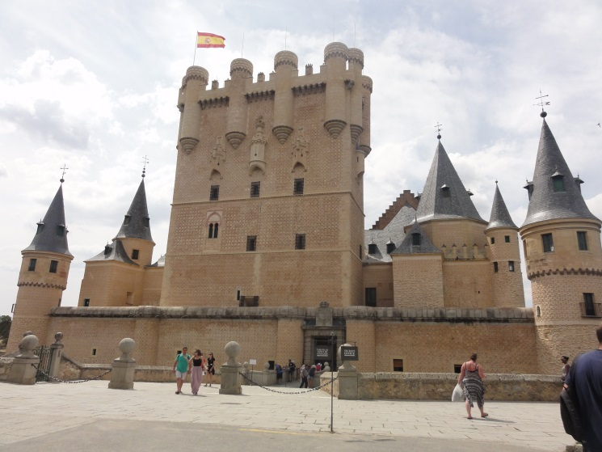
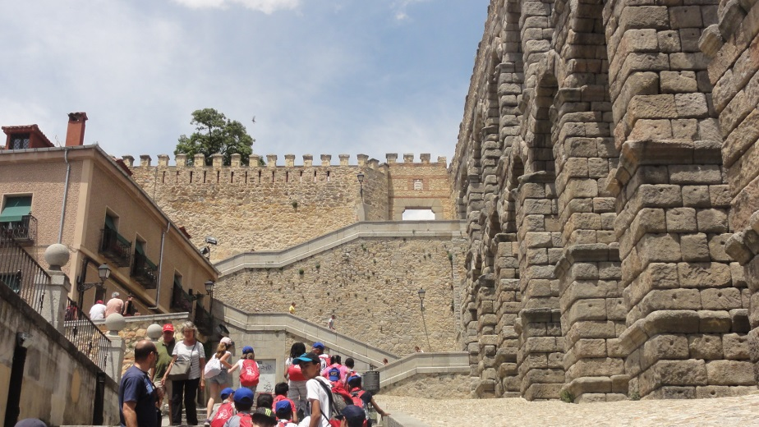

Slide 12
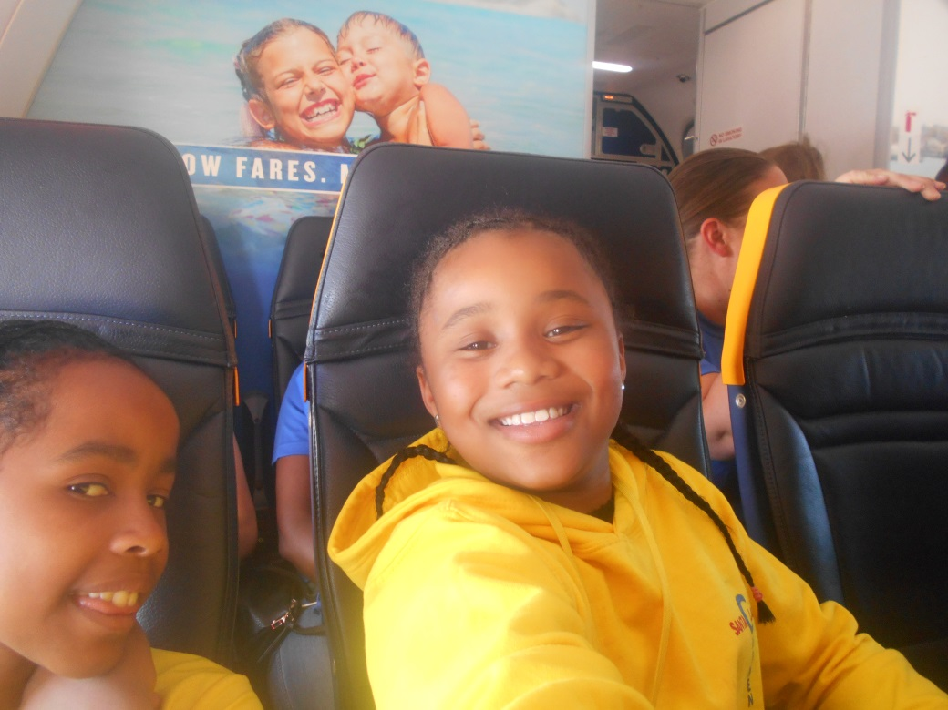
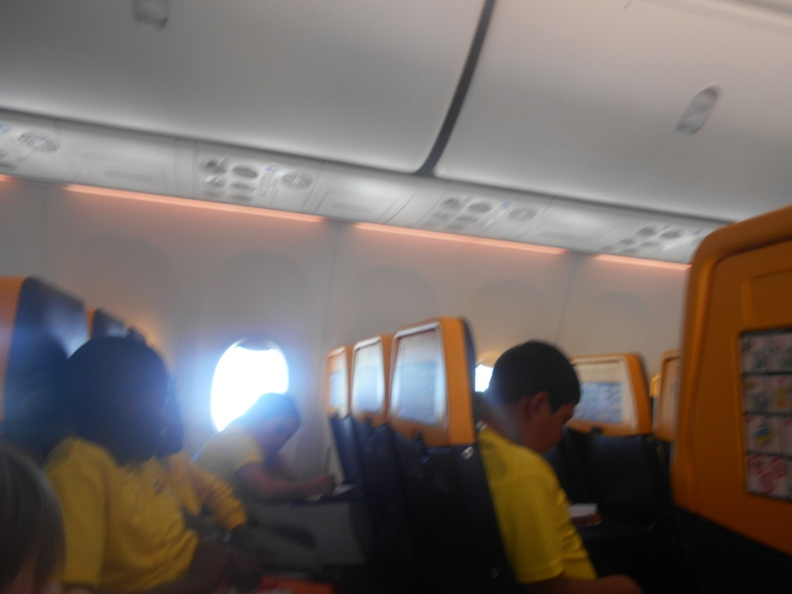

Slide 13
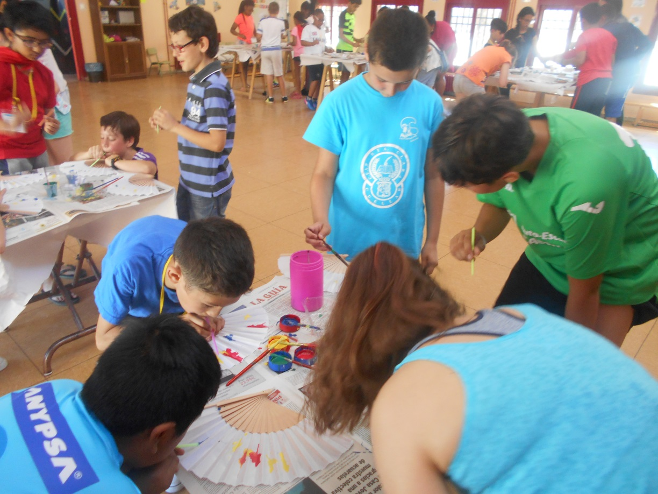
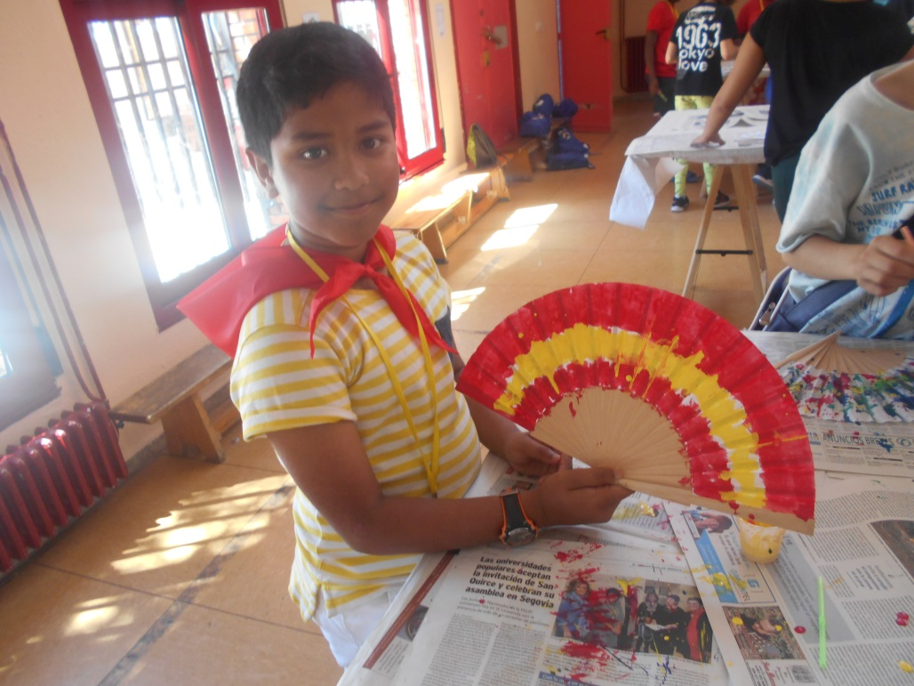
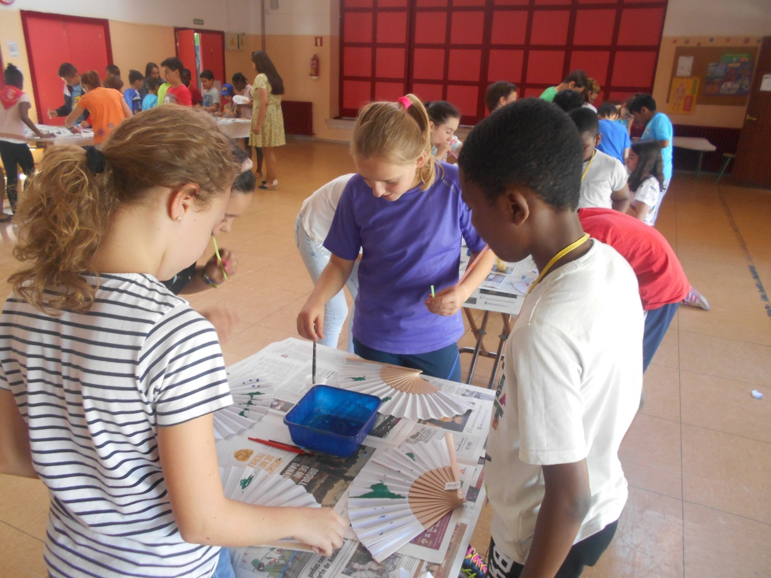

Slide 14
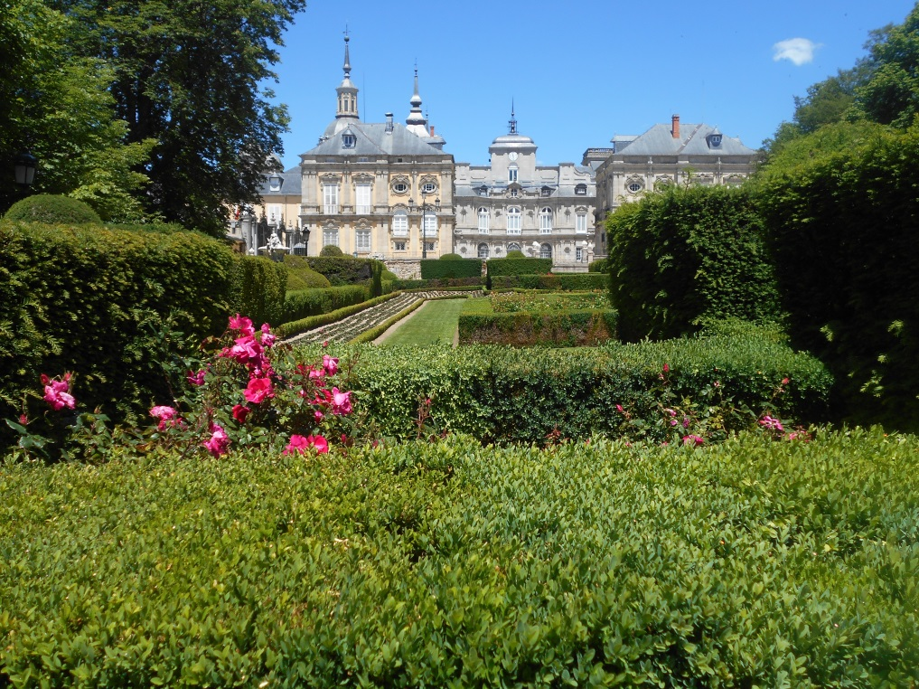
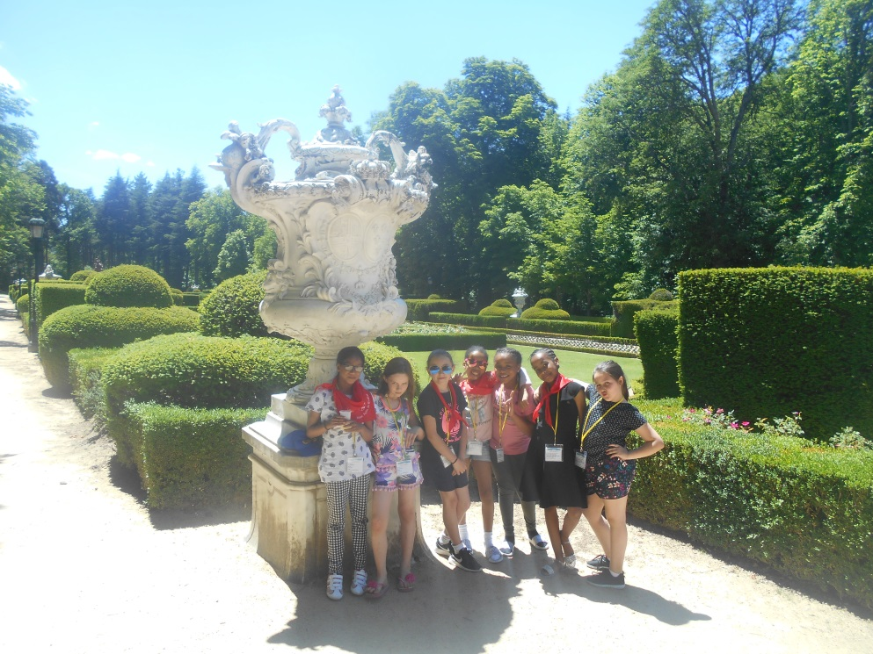
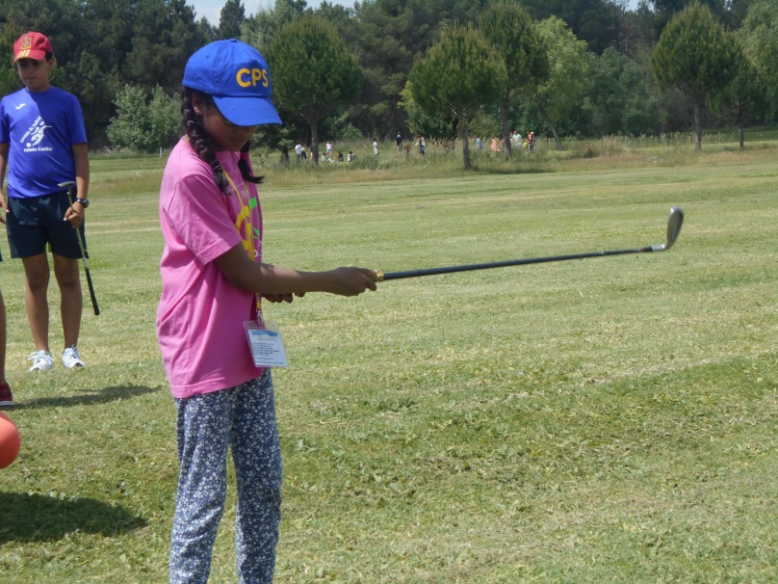
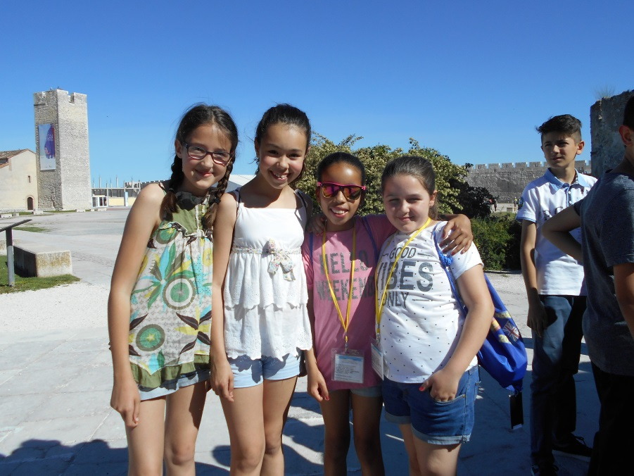

Slide 15
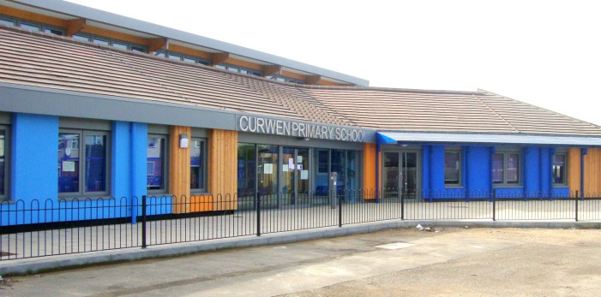
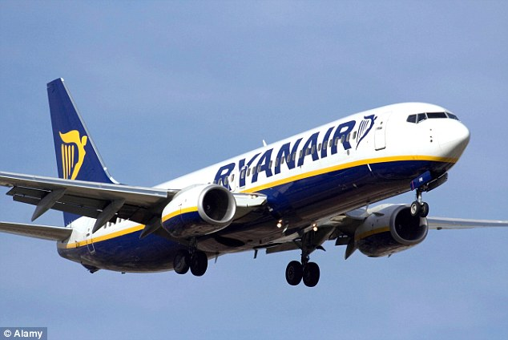
Travel
We will travel by coach to and from airports
30 Children and 6 adults
Mrs Marle
Ms Tome
Mr Cullen
???????
Miss Twatchman
Miss Tully
From Stansted airport to Madrid Airport
The flight will take just under 2 hours

Slide 16
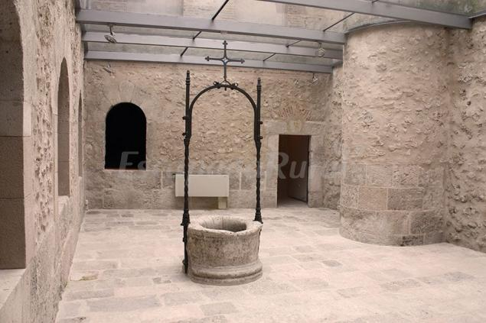
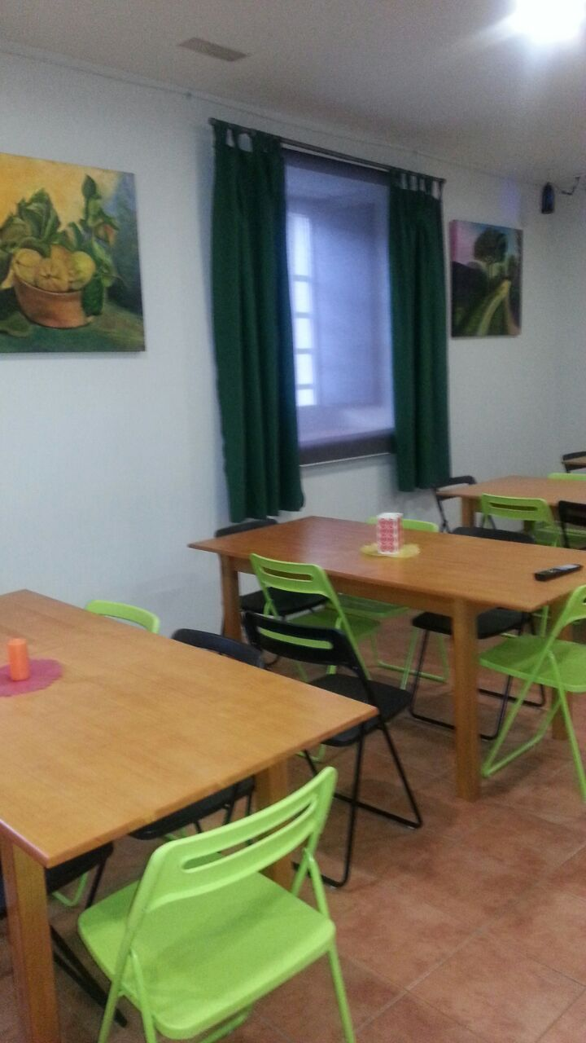
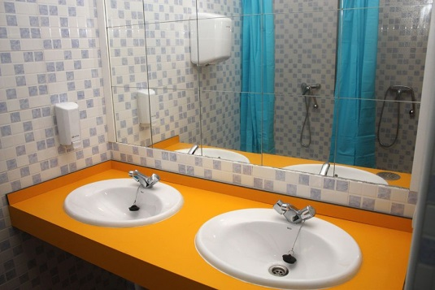
Accommodation
Albergue de la Magdalena
Cuéllar – Segovia
Full board
Exclusive usage of facilities
Packed Lunches provided
No Halal - Lots of vegetarian options
Dormitory accommodation
http://www.elalberguedelamagdalena.es/index.php

Slide 17
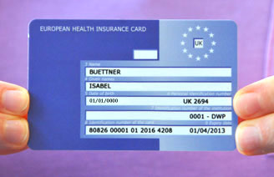
EHIC
European Health Insurance Card (or EHIC)
Allows anyone who is insured by or covered by a statutory social security
scheme of the EEA countries to receive medical treatment in
another member state free.
So……If your child has a UK NHS number
he/she can have free medical treatment in Spain
EHIC card is free
Apply on line you only need…full name + DOB + NHS number
The applicants must be ordinarily resident in the UK
Apply By 19/12/2019

Slide 18
EHIC
EHIC after Brexit
The European Health Insurance Card (EHIC) may not be valid if there's a no-deal Brexit. This will depend on arrangements with individual countries.
If you're using an EHIC issued by the UK, this will remain valid until the UK leaves the EU.
Apply By 19/12/2019

Slide 19

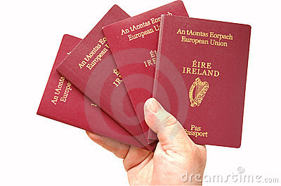
Do you have a passport?
When does your child’s passport expire?
Passports should be renewed if it has less than six months left from the date of travel
How much does it cost to renew a passport? (British)
£49 online or post
£59 Check and Send
Apply By 19/12/2019

Slide 20
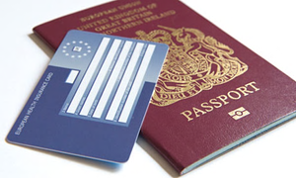

Your child MUST have a valid EU/UK passport and EHIC card
If you need a EHIC or a passport:
We can offer support in filling in applications.
The school will countersign passports for a fee of £5.
Your child must have been a pupil at Curwen for over 2 Years.
Please let us know TODAY if your child does not hold a EU/UK passport
(VALID until December 2020)

Slide 21
It is either Spain or The Lake District
You child can only attend one.
If your child does not have a valid EU/UK passport he cannot go to Spain with the school this year.
Until Brexit is finalised the British Council does not give assurances that a child would not be refused entry into Spain or back in the UK

Slide 22
COST
Total trip cost per person £500
SchoolMoney
You pay £250
Curwen will pay additional £250 per child
If your child is eligible for free school meals £150
ALL money must be paid to main office.
Please ensure you keep your receipts!

Slide 23
DEPOSIT
Deposit in Cash
To secure your place, we will need £50 deposit (in cash) ON 2nd December (From 8.00am) and a copy of your child’s passport, EHIC, completed consent form and medical form.
Spaces will be allocated on a first come first serve basis.
The remaining £200 must be paid on the 1st week of each month through SchoolMoney

Slide 24
BOOK YOUR SPACE TODAY!!!
ONLY 30 SPACES AVAILABLE!
5 Reserve Space will be allocated
If you have a reserve space you must attend all meetings and hand-in all documents before the deadline.

Slide 25
COST
ALL money must be paid to the main office.
*2nd Dec pay £50
*13th Jan pay £50
*3rd Feb pay £50
*2nd Mar pay £50
SchoolMoney/ Cash
*Final payment of £50 by 21st April
Collection of spending money 18th May
£50 to be paid in cash
To ensure children get the best rate
school will change ALL pupils spending money into Euros

Slide 26
Decision
Spain or Lake District

Slide 27
School’s assurances
Agreement
Arrange meetings to ensure effective communication with parents and provide parents with necessary information about the trip
Arrange meetings with individual parents when necessary
Meet with school nurse to ensure all pupils’ medical needs are met and complete any relevant care plans.
Complete risk assessment of trip
Collecting money and exchange currencies
Arrange flights, accommodation and transport
Daily update on school website during the trip
In the event of an emergency communicate with school and parents

Slide 28
I ______________ (Parent/ Carer insert full name) agree to:
Meet ALL payment deadlines as listed
ALL medical information will be accurate and up to date
All consent forms handed in by December 16th 2019
My child’s valid passport will be handed into the school office by January 31st 2020 and valid until December 2020.
A valid EHIC (European Health Insurance Card) will be handed into the school office by January 31st 2020.
Be available to meet with school nurse and visit leads to discuss child’s medical needs.
Attend meetings final meeting 18th May 2020
While my child is in Spain, in the event of an emergency, I will be available to be contacted
Ensure my child arrives on time with agreed luggage
Be available to collect your child at the end of the trip
Complete end of trip questionnaire

Slide 29
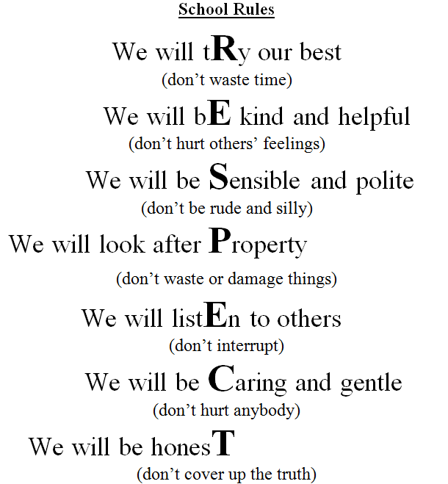
Child’s agreement
The expectation is that your child continues to behave exceptionally in all my lessons, inside and outside of school. As a condition your child’s behaviour will continue to be monitored closely to ensure they continue to represent Curwen to a high-standard.
I ___________________________ (insert full name) agree to continue to behave exceptionally in all my lessons, inside and outside of school. I understand that my behaviour will continually monitored and if there are any concerns my place could be given to another child.

Slide 30
This contract must be up held in order for your child to have a confirmed place on the 2020 Spanish trip. In the event that you do not adhere to the above agreed deadlines you child’s place will be given to another child. We ask for this to ensure that all the children have the best possible experience.
Agreement

Slide 31
* Travel consent form
Why we need it?
* Photo Consent

Slide 32
MEDICAL INFORMATION AND CONSENT FORM
This form MUST be completed and signed by the Parent/Guardian of the child
Important:
Medication needs
Doctor’s information
Correct contact details

Slide 33
Medication
Has your child EVER suffered from:
Asthma
Hay-Fever
Migraines
Vomiting
Travel sickness
Skin irritation
Allergies to ANYTHING
ANY OTHER CONDITIONS
Hay fever signs and symptoms can include:
Runny nose and nasal congestion.
Watery, itchy, red eyes (allergic conjunctivitis)
Sneezing.
Cough.
Itchy nose, roof of mouth or throat.

Slide 34
Has your child EVER:
Sleep walked
Had night-terrors
Suffer from ANY form of anxiety
Has any phobias

Slide 35
Dates to remember
Once initial commitment of £50 is paid, signed consent, medical form and all travel documentation are handed in your child will have a confirmed place.
*Monday 2nd November – Copy of child’s passport, EHIC £50 deposit, consent forms to Ms Welch
*Monday 16th December ALL consent forms handed in to main office (deadline)
*Friday 31st January Passport & EHIC (deadline)
*Final meeting 18th May: Meeting-Collection of clothing and spending money (£50), Trip itinerary

Slide 36
2020 YR5
Trip to
SPAIN
BOOK YOUR SPACE TODAY!!!
ONLY 30 SPACES AVAILABLE!

