Slide 1

MASTER
SKILLS
SKILLS MASTERCLASS
Notes:
This presentation is all about learning skills – what it takes to learn new skills, using examples from Team GB athletes, and exploring the key food preparation skill of working with knives.

Slide 2

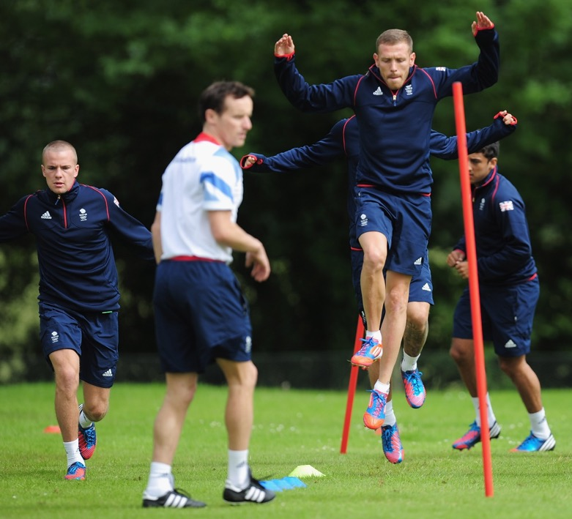

MASTER
SKILLS
Learning skills
Learning new skills is an important part of life.
Talk to a partner
Can you think of a new skill you have learnt recently? How did you learn what to do?
When you learn a new skill it helps when you have:
someone to show you what to do
lots of chances to practise
a goal to work towards.
Notes:
This first activity is a good way to get young people thinking about skills. You can look at what skills they have already learnt in life and the learning process they went through. The focus here is on the fact that learning new skills, no matter what they are, involves many of the same processes.
The greater the range of skills discussed the better, as pupils will understand that there are common steps in the learning process, no matter what you are learning to do.
For younger children, you may wish to suggest skills they have learnt at school or refer to key milestones for that age group. Suggest ideas for how they learnt what they did. Did someone show them? Did they have lots of different attempts before they got it right?
Older children can provide more insight into how they learnt what they did. What was hard about learning the new skill? What made it easier?
Photo: Craig Bellamy of the Team GB Football team warms up during a Team GB Football training session ahead of the London 2012 Olympic Games.

Slide 3
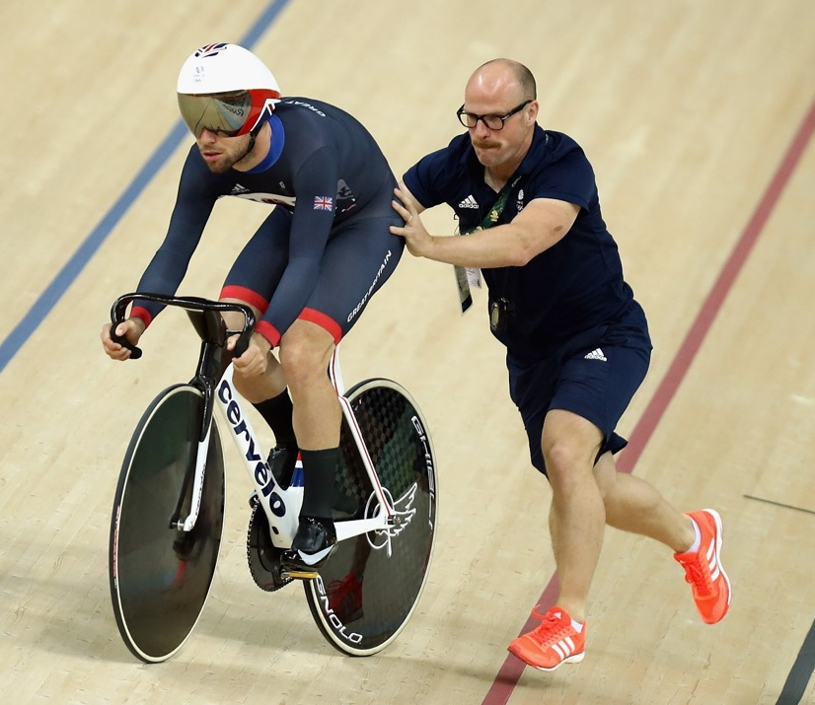
MASTER
SKILLS
Learning from someone else
Team GB athletes work with coaches to learn new skills or to get better at their sport.
Why do you think it helps to work with someone to learn a skill?
They show you what to do.
They tell you if you are doing things right.
They tell you if you are improving.
It makes you feel confident.
It motivates you.
Notes:
This activity encourages pupils to think about why it helps to work with someone when learning a new skill. Answers are provided on the slide – but children should not be restricted by this list.
Photo: Mark Cavendish gets a push up the track from coach Jan van Eijden during training at the Rio Olympic Velodrome during the Rio 2016 Olympic Games.

Slide 4
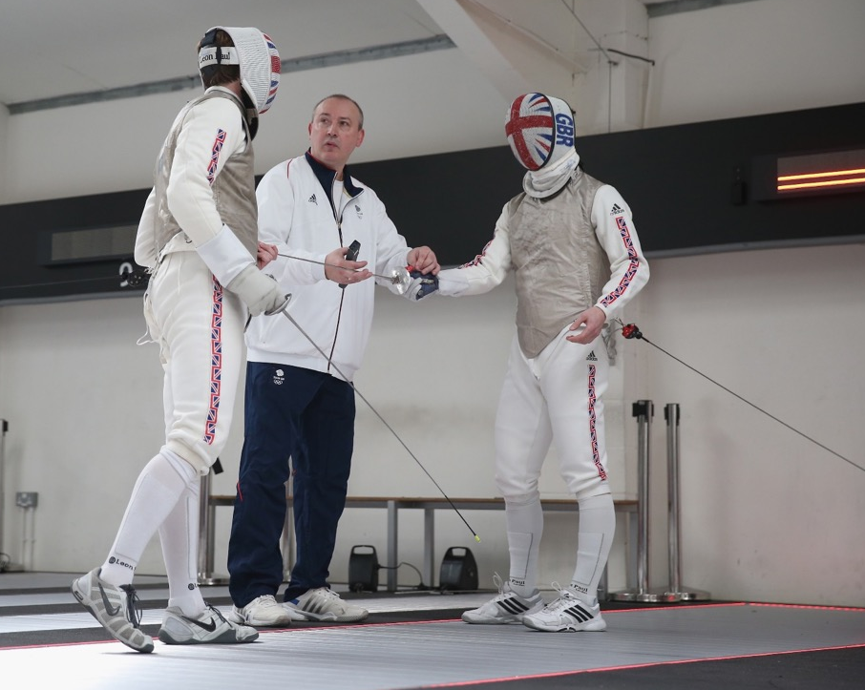
MASTER
SKILLS
Learning from someone else
A coach and the person they are coaching need to work well together.
How should a coach behave?
How should the person being coached behave?
Notes:
This slide encourages pupils to think about the behaviours you need to show as a coach and as someone being coached.
How should a coach behave?
Be positive and encouraging
Explain things clearly
Show patience
Show what needs to be done
How should the person being coached behave?
Listen carefully
Watch closely
Ask questions
Say ‘thank you’
Stay positive and focus on improving
For younger children, you may wish to focus just on how the person being coached needs to behave. You may wish to display behaviours – listening well, asking questions, etc. – and ask the children to decide which ones would help them to learn a new skill.
Older children should be encouraged to reflect on the importance of a coach and the person being coached working well together as a team, sharing responsibility for the person improving. They can also give reasons for some of the behaviours. For example, listen carefully – so they know what to do.
Photo: Laurence Halsted, British Fencing head coach Andrey Klyushin and Marcus Mepstead at British Fencing's Elite Training Centre in May 2016 ahead of the Rio 2016 Olympic Games.

Slide 5
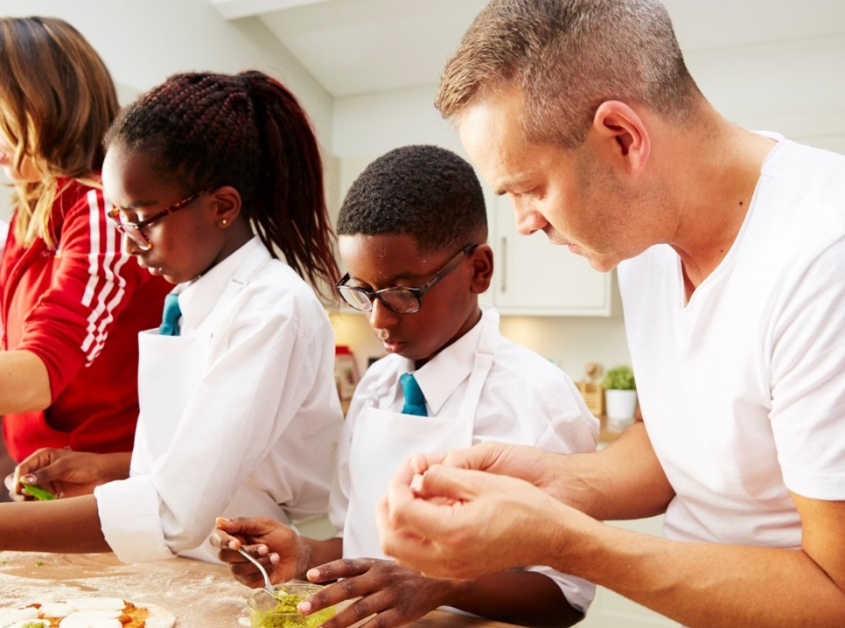
MASTER
SKILLS
Learning from someone else
Watch a new skill being taught.
What do you notice?
Notes:
Should you have the time, this slide offers the opportunity to build on the previous discussion on how the coach and person being coached. This short activity is most suited to older pupils.
Ask someone (a pupil, now acting as a coach) to show you how to do something – perhaps a particular dance move. Ask the rest of the pupils to think about three things while watching:
What did the pupil/coach say?
What did I (the teacher, acting as learner) say in response?
How could we work better together?
Ask pupils to think about the following during the subsequent discussion:
Did the coach give a commentary of what they were doing when they first demonstrated what to do?
Did the coach then give space for the person being coached to have a go?
Did the coach ask either of these questions?
How do you think you are doing?
Can you remember what to do next?
Did the coach give gentle reminders when things went wrong (for example, “Let me show you that bit again.”)?
Did the coach give praise?
Did the person being coached listen carefully, ask questions, stay positive?

Slide 6
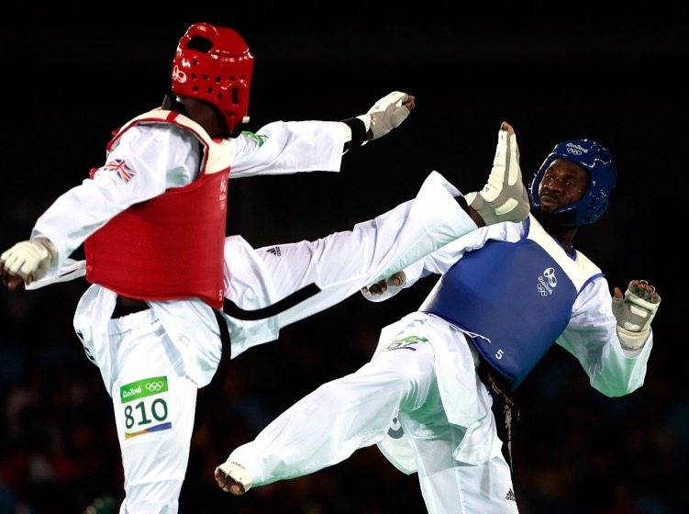
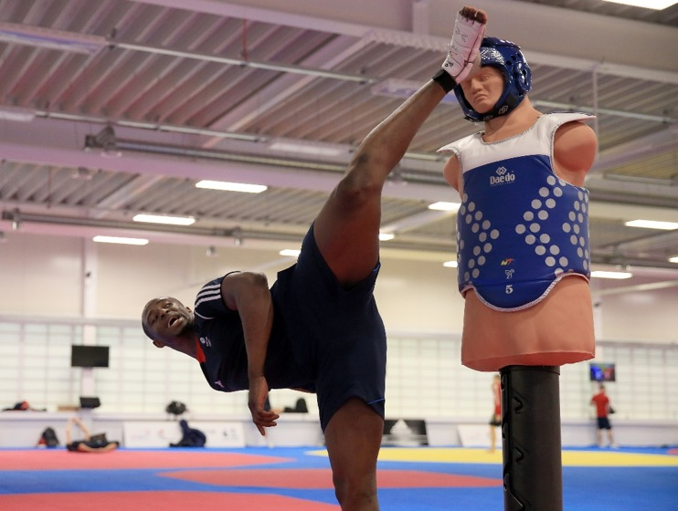
MASTER
SKILLS
Learning step-by-step
Look at these two images.
What is the same?
What is different?
Notes:
This slide introduces the importance of learning skills step-by-step.
These two images reinforce the idea that lots of hard work goes into a final performance.
Similarities between the images include:
Same person (Mahama Cho) in both
Same person doing the same sport (taekwondo)
Kick in both photos
Similar leg position, striking a similar point on opponent
Differences between the images include:
Environment – one is in a gym, the other is in competition
Kit – one is in training kit, the other is in formal clothing for performance, including protective gear
Opponent – one is against a dummy, the other is against an actual opponent (Anthony Mylann Obame of Gabon)
Movement – in one he is just doing a kick, in the other the whole body is in movement
Photo: Mahama Cho in training and Mahama Cho competing against Anthony Mylann Obame of Gabon at the Rio 2016 Olympic Games.

Slide 7
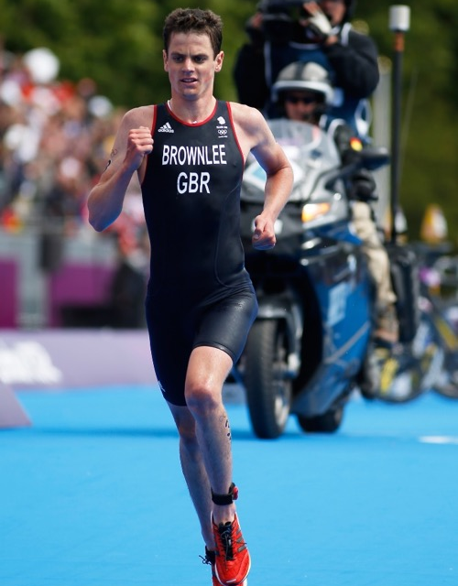
MASTER
SKILLS
Practising skills
“
Being a triathlete is a never-ending learning process. Each race you find something you can do better. You find the areas where you know you can put in more effort – then practise, practise, practise.
Jonny Brownlee, Team GB athlete
Read these top tips for practising new skills.
How do you think these tips help you to get better?
Practise often – a little bit everyday or every few days
Set yourself a goal
Record how you do
”
Notes:
Alongside learning skills step-by-step, it is really important to practise new skills.
You may wish to discuss how everyone feels about practising. Do they find it easy or hard? Fun or boring?
Read the quote from Jonny Brownlee and then follow with the top tips for practising new skills. Discuss why, even though practising may feel like hard work, it can help us to get better.
How do the tips help you to get better?
Practise often – the more you do something, the easier it gets and the more confident you feel about it.
Set goals – when you have something to work towards you know what you are aiming for and you also feel motivated.
Record how you do – you understand if you are getting better.
Encourage practice by having a class goal list, rewards for achievement and presentations when key skills are successfully achieved.
Photo: Jonny Brownlee during the race section of the triathlon at the London 2012 Olympic Games.

Slide 8

MASTER
SKILLS
Learning
new skills
What helps us to
learn new skills?
Notes:
This slide provides a brief opportunity for pupils to reflect on everything they have discussed about learning new skills before they go on to explore using knives for food preparation.
Things that help us to learn new skills:
Learn from someone else
Show behaviours that help us to learn, especially when working with someone else
Learn step-by-step
Practise
Work towards a goal
Measure how we do

Slide 9
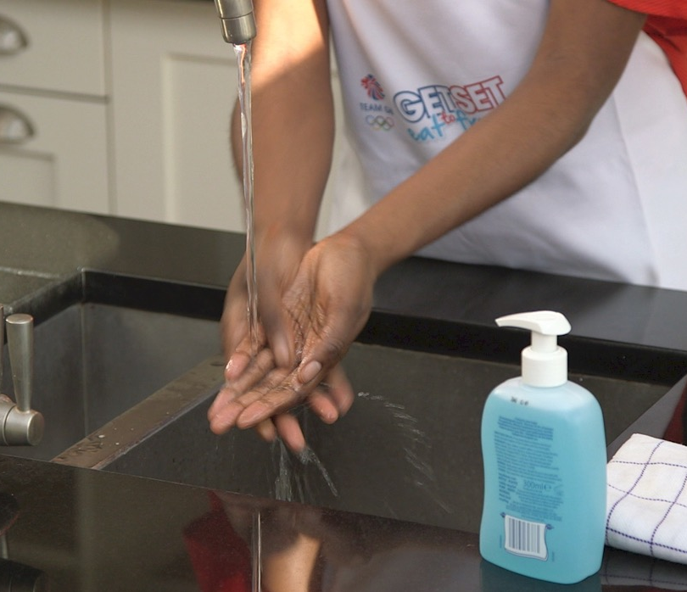
MASTER
SKILLS
Skills masterclass:
knife skills
Today we are going to practise knife skills – using knives to prepare food.
Before getting started:
  Check equipment – chopping board and knife
  Check clothing
  Check clean hands
  Check position – need to stand or sit securely
Notes:
You may wish to show the Master Skills film (getseteatfresh.co.uk/resources/master-skills) at this point in the presentation. The film features ‘Get Set to Eat Fresh’ presenter Jacqueline using knife skills for food preparation.
Impress on pupils the importance of preparation before learning a new skill.
Encourage pupils to check each other against the checklist – have they ticked off all the preparation steps? Make sure pupils are listening carefully in readiness for when they need to listen to actual instructions on using knives.
A few tips on knives and boards
Use a colour-coded chopping board.
Always use a knife that matches the size of the pupil’s hands (small hands = small knife).
Sharp knives are usually safer than blunt ones, as blunt knives may slip.
Supervise the use of knives until the pupils can use them safely and confidently.
Insist that the pupils pay attention and focus on the item being cut at all times.
A few tips on preparing for demonstrations
Plan what you are going to do and say in advance.
Break down the process into smaller stages.
Think about the possible tricky points for pupils – for example, holding the equipment the right way.
Choose the most important points to tell pupils. How will you help them remember? They could make notes or take photos.
Plan some questions.
Find out if there are any health and safety issues and carry out Risk Assessments as necessary.
Have the equipment and materials ready and well laid out.
A few tips for when you are demonstrating
Demonstrations are interactive, not one-way dialogues.
Keep the group size small.
Position yourself so that everyone can see, check that they can sit or stand comfortably and not get distracted.
Explain each step clearly and simply as you demonstrate. You are modelling good technique.
Work much more slowly than usually and provide a running commentary to point out the detail of each stage.
Reinforce the important points. Repeat your points and try to explain why things are done in a particular way. Emphasise points by drawing pupils attention to them…. Do you see how this…? Pause and let the pupils look.
Make sure the pupils pay attention. Involve them by asking questions, make them taste, touch, handle, look, smell, listen… to get a better understanding. For example, when mixing dough you may wish to reinforce the point about how wet/dry it will be.
Keep eye contact with the group and check they understand. Involve them if you can, for example by holding things, measuring, choosing.
Recap on what you have done at the end. If they are going to carry out the task immediately make sure that all the pupils know the first couple of steps.
Further information on developing these skills, along with a pupil progression chart, is available for a small cost from the Design and Technology Association: https://www.data.org.uk/resource-shop/lgp-are-you-teaching-food-in-primary-dt/

Slide 10
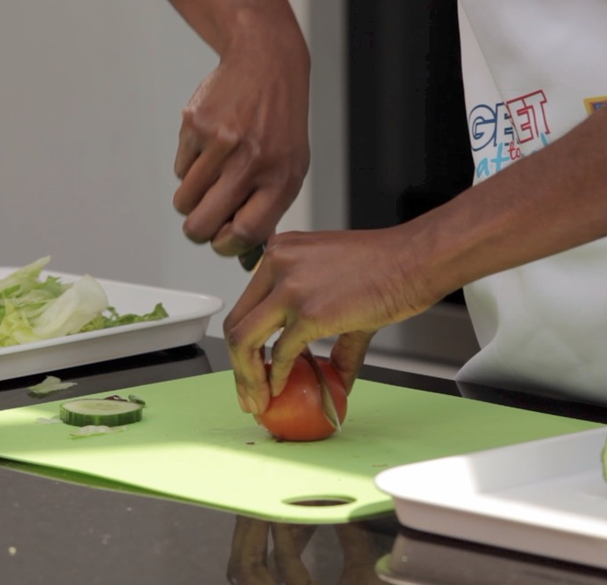
MASTER
SKILLS
The bridge hold
What shape is
Jacqueline making
with her hand?
Where are her fingers?
Where is her thumb?
What surface is Jacqueline using
to cut on?
How big is the knife Jacqueline
is using?
Think about how it looks in her
hand and next to the tomato.
How is Jacqueline holding
the knife?
Think about how she will
move the knife when cutting.
Notes:
This slide talks through the bridge hold. Ask pupils to think about the prompts on the slide.
Key points to emphasise with the bridge hold
Use a chopping board.
Always use a knife that suits the size of your hand and the item being cut.
Make a bridge over the vegetable or fruit with your hand. Fingers should be on one side and thumb should be on the other.
Pick up the knife with the other hand and check that the blade is facing downwards.
Guide the knife under the bridge and over the food.
Cut into the vegetable or fruit by pressing the knife down and pulling it out of the bridge.
It can help to think of the knife as a train/car which goes under the bridge.
The most common mistake is that after a few cuts fingers start to slide into a horizontal position. Keep reminding pupils to keep the ends of their fingers vertical (digging in their fingernails).
Top tips for practising the bridge hold
Break the bridge cut down into small steps – such a making the bridge shape, holding the knife, practising the knife movement.
Practise with softer foods first, such as strawberries, before moving onto harder foods, such as carrots and potatoes. Advice on what foods are suitable for different age groups can be found here: http://www.foodafactoflife.org.uk/Sheet.aspx?siteId=14&sectionId=62&contentId=70
Always work flat side down. If there is a flat surface to the fruit or vegetable, this should be laid flat on the chopping board.
If the food is too big for the pupils to manage, pre-prepare it by cutting it into manageable sizes for them to work on.
The point of the knife at the tip may be used on food like tomatoes to pierce the skin to start a cut.

Slide 11
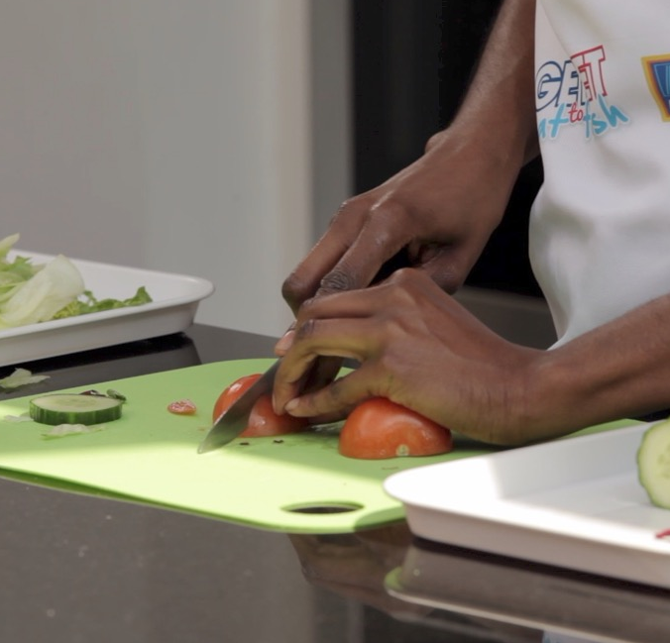
MASTER
SKILLS
The claw hold
What shape is
Jacqueline making
with her hand?
Which way are her finger tips pointing?
What do you notice about the tomato?
Which side is on the board?
How big is the knife Jacqueline
is using?
Think about how it looks in her hand and next to the tomato.
How is Jacqueline holding
the knife?
Think about how she will move
the knife when cutting.
Notes:
This slide talks through the claw hold. Ask pupils to think about the prompts on the slide.
Key points to emphasise with the claw hold
Use a chopping board.
Always use a knife that suits the size of your hand and the item being cut.
Make a claw with your hand by partly curling your fingers together.
Pick up the knife with your other hand and check that the blade is facing downwards.
Tilt the knife and slice through the vegetable or fruit, using your fingers as a guide.
Slide your fingers back, keeping your grip on the food, and continue slicing carefully.
Keep the ends of your fingers vertical, almost as if you are digging in your fingernails.
Keep your thumb well back and away from the knife.
The most common mistake is that after a few cuts fingers start to slide into a horizontal position. Keep reminding pupils to keep the ends of their fingers vertical (digging in their fingernails).
Top tips for practising the claw hold
Break the claw cut down into small steps – such a making the claw shape, holding the knife, practising the knife movement.
Practise with softer foods first, such as strawberries, before moving onto harder food, such as carrots and potatoes. Advice on what foods are suitable for different age groups can be found here: http://www.foodafactoflife.org.uk/Sheet.aspx?siteId=14&sectionId=62&contentId=70
Always work flat side down. If there is a flat surface to the fruit or vegetable, this should be laid flat on the chopping board.
If the food is too big for the pupils to manage, pre-prepare it by cutting it into manageable sizes for them to work on.
The point of the knife at the tip may be used on food like tomatoes to pierce the skin to start a cut.

Slide 12
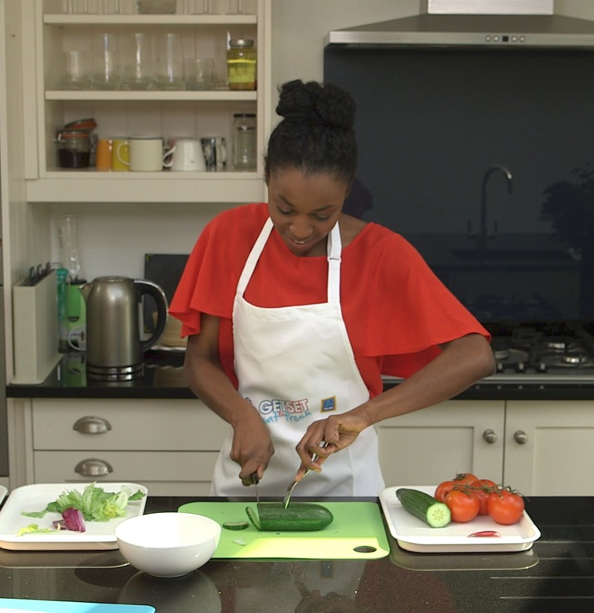
MASTER
SKILLS
The fork secure
How is Jacqueline using the fork?
How do you think this helps?
What do you notice about the cucumber?
What surface is Jacqueline using to cut on?
Notes:
This slide talks through the fork secure. Ask pupils to think about the prompts on the slide.
Key points to emphasise with the fork secure
Use a chopping board.
Always use a knife that suits the size of your hand and the item being cut.
Hold the fork in your non-writing hand and plant it firmly into the fruit/vegetable in an upright position so it feels nice and secure.
Think about where the fork is placed into the fruit/vegetable – place it centrally so it is nice and secure. You may need to move it if you need to cut more of the fruit/vegetable.
Tilt the knife and slice through the fruit/vegetable.
Top tips for practising the fork secure
Break the fork cut down into small steps – such a holding the fork, planting the fork, holding the knife, practising the knife movement.
Practise with softer foods first, such as strawberries, before moving onto harder food, such as carrots and potatoes. Advice on what foods are suitable for different age groups can be found here: http://www.foodafactoflife.org.uk/Sheet.aspx?siteId=14&sectionId=62&contentId=70
Always work flat side down. If there is a flat surface to the fruit or vegetable, this should be laid flat on the chopping board.
If the food is too big for the pupils to manage, pre-prepare it by cutting it into manageable sizes for them to work on.
The point of the knife at the tip may be used on food like tomatoes to pierce the skin to start a cut.
The fork is used to secure the food and keeps the fingers completely clear from where the knife may slip.

Slide 13
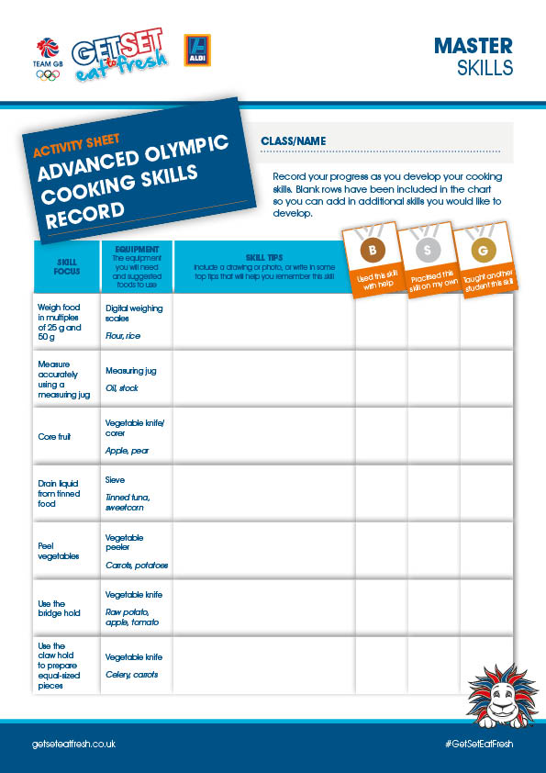
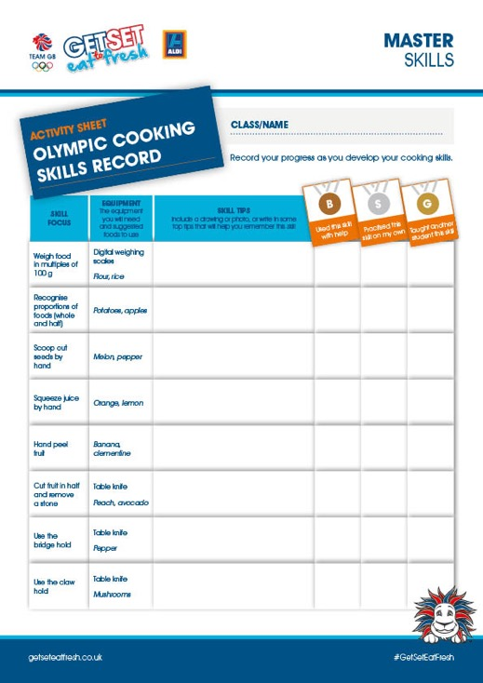

MASTER
SKILLS
Practising knife skills
When can we practise
our knife skills?
Notes:
Discuss with pupils what opportunities they will have to practise their knife skills. The aim here is to help pupils identify all the times they could make use of knife skills – and to think of some concrete examples where they could practise outside of the classroom.
Pupils should be encouraged to see practice as fun and an opportunity to be creative. Pupils could be encouraged to set goals.
What is their goal?
How will they practise?
When?
Who will help them?
You may also wish to make use of the Olympic Cooking Skills Record and the Advanced Olympic Cooking Skills Record to set goals as a class and to measure progress. The charts can be downloaded here: getseteatfresh.co.uk/resources/master-skills
Times when knife skills can be used:
Helping to prepare a packed lunch at home.
Helping to prepare fruit or vegetables for a family meal, but bear in mind that younger children should start off preparing softer fruits and should have supervision.
Working together to make a class meal.
Preparing foods for a school smoothies stand.

Slide 14

MASTER
SKILLS
Celebrating
new skills
Learning a new skill
is a great achievement!
You could create a step-by-step video or help your teacher in class
Notes:
This slide encourages pupils to celebrate all the effort they have put in to mastering a new skill.
Ask pupils how learning a new skill has made them feel? How will it help them in their daily life?
Taking it further
A great way for pupils to celebrate their new skill and reinforce their learning is to create a step-by-step instruction sheet or video for other pupils in the school.
Celebrate pupils’ new knife skills and share your instruction sheets or videos on getseteatfresh.co.uk/community for the chance to win exclusive prizes.

